Slide 1
Bridging the gap
From primary to secondary education

Slide 2
content
Introduction
Mentimeter
Educational system in the Netherlands
English lessons in primary school
English lessons in secondary school
Mentimeter
How do we bridge the gap?
Any questions?

Slide 3
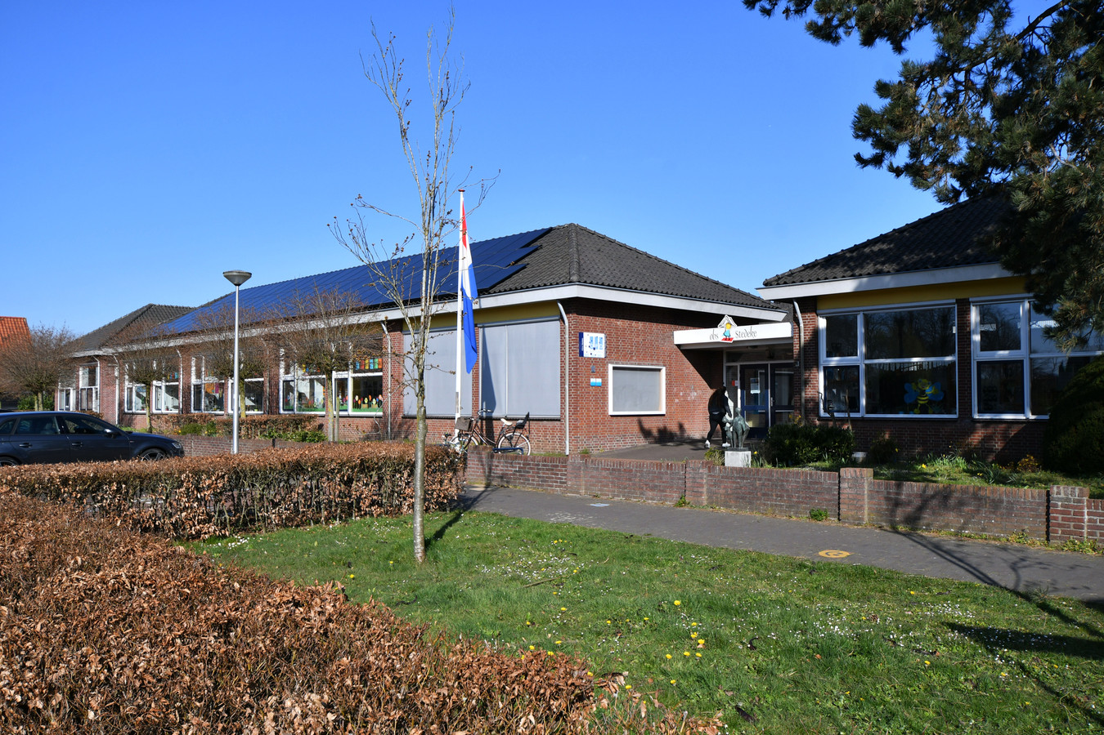
Introduction
Pascalle Bobbink
Primary school obs Stedeke in Diepenheim
Diana Menger
Secondary school SG the Waerdenborch in Goor

Slide 4
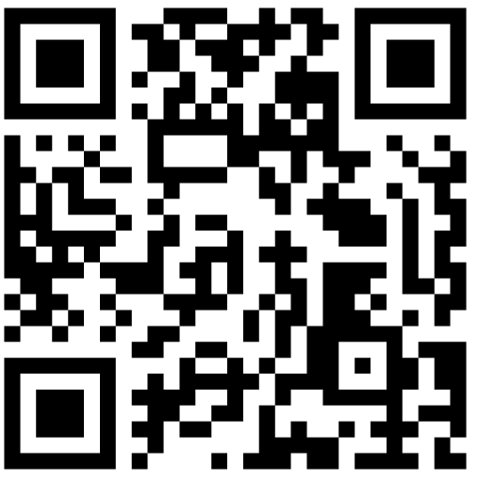
Mentimeter

Slide 5
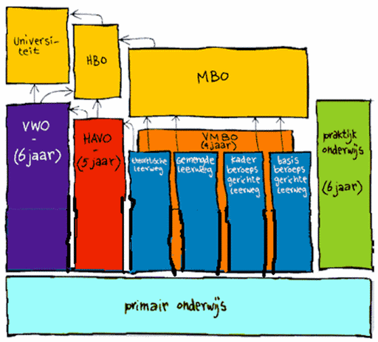
Eductional system in the Netherlands

Slide 6
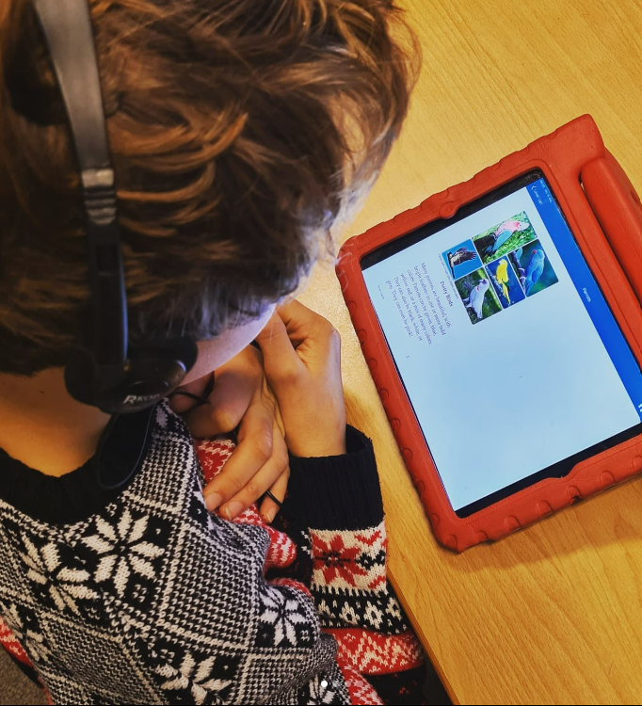
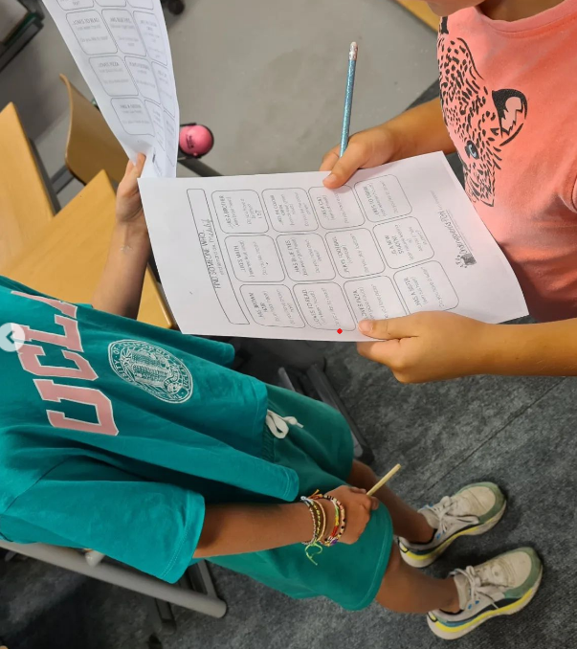
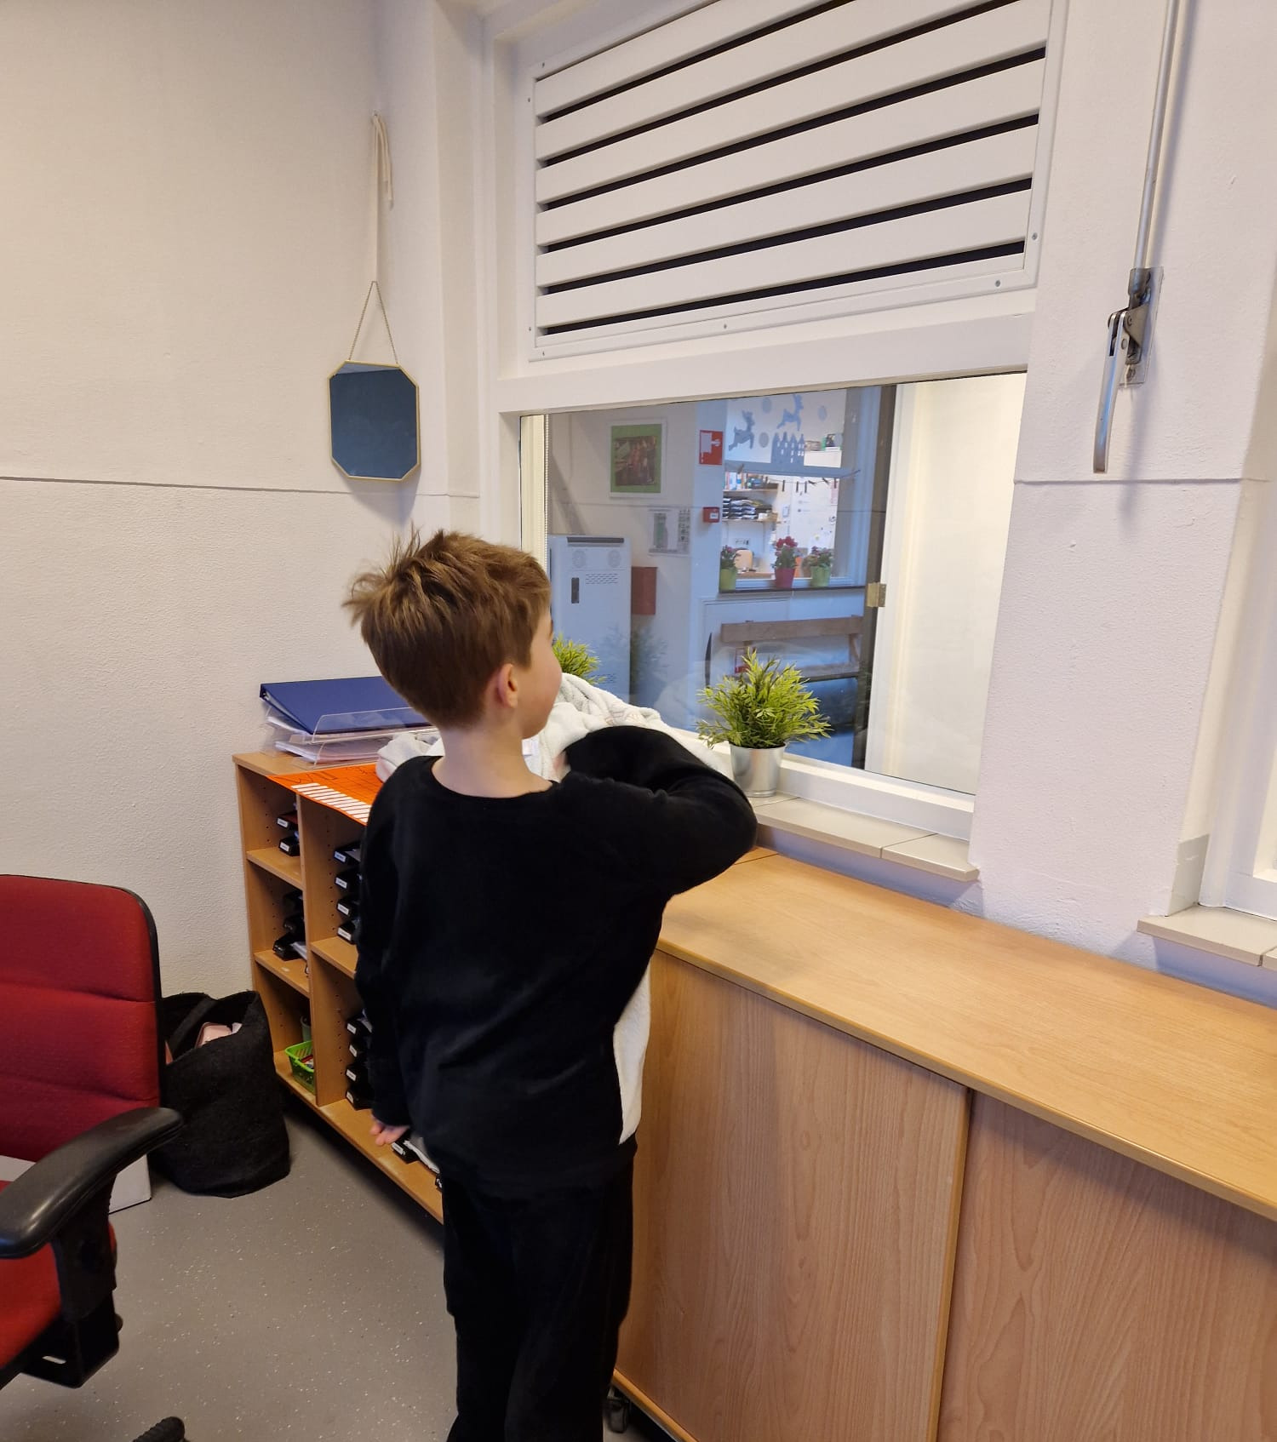
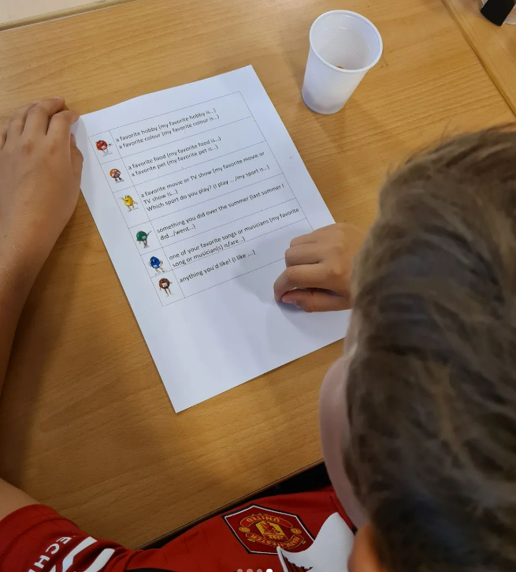
English lessons in primary school

Slide 7
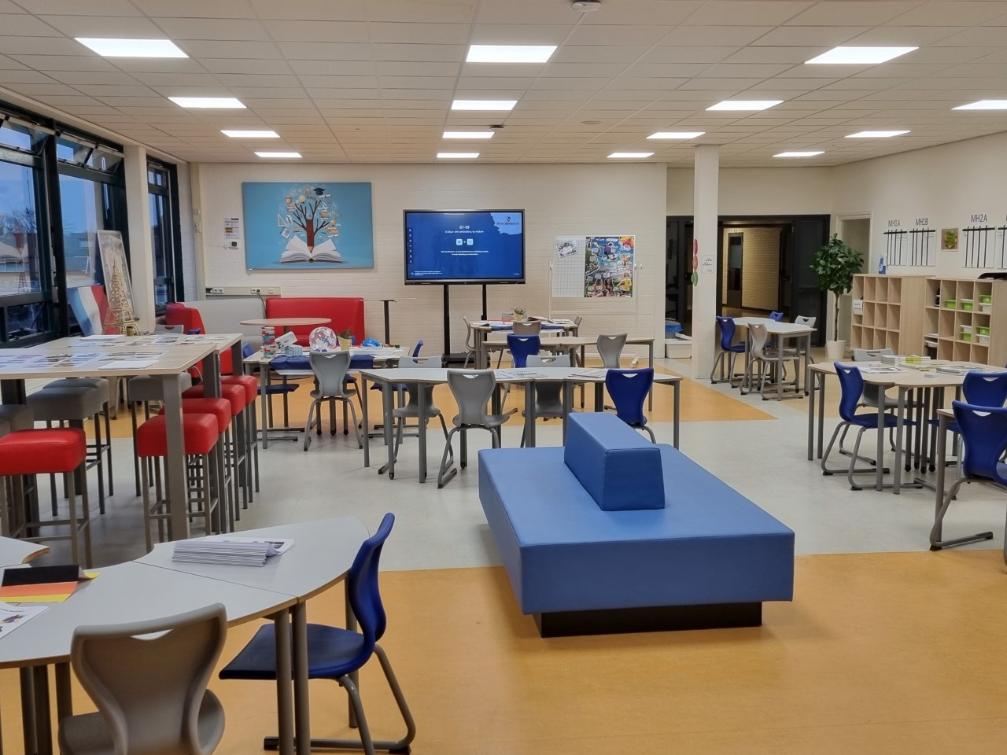
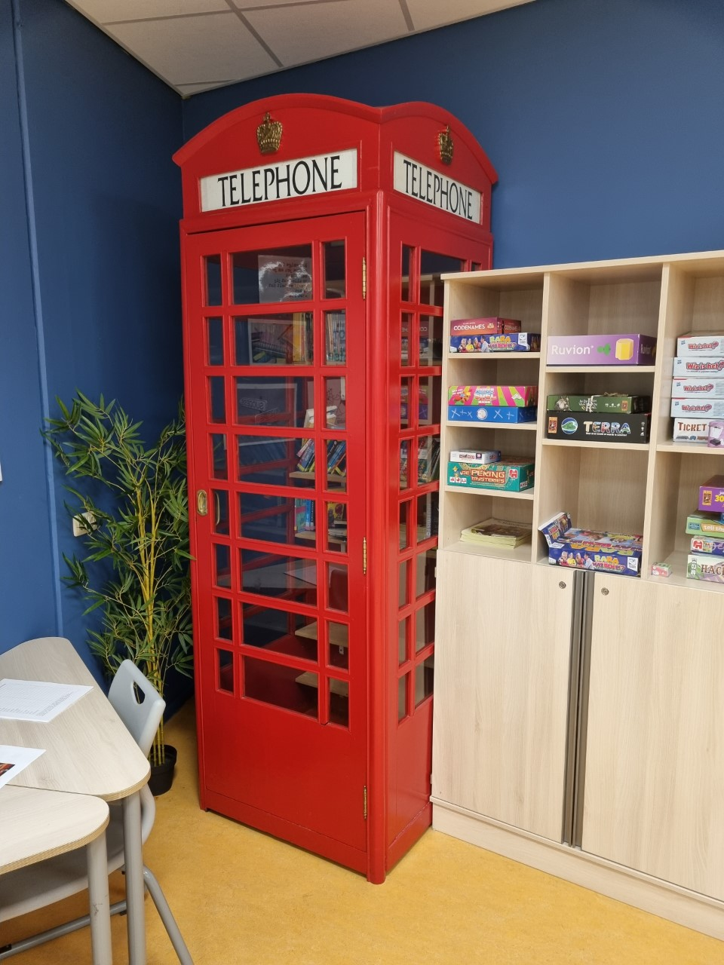
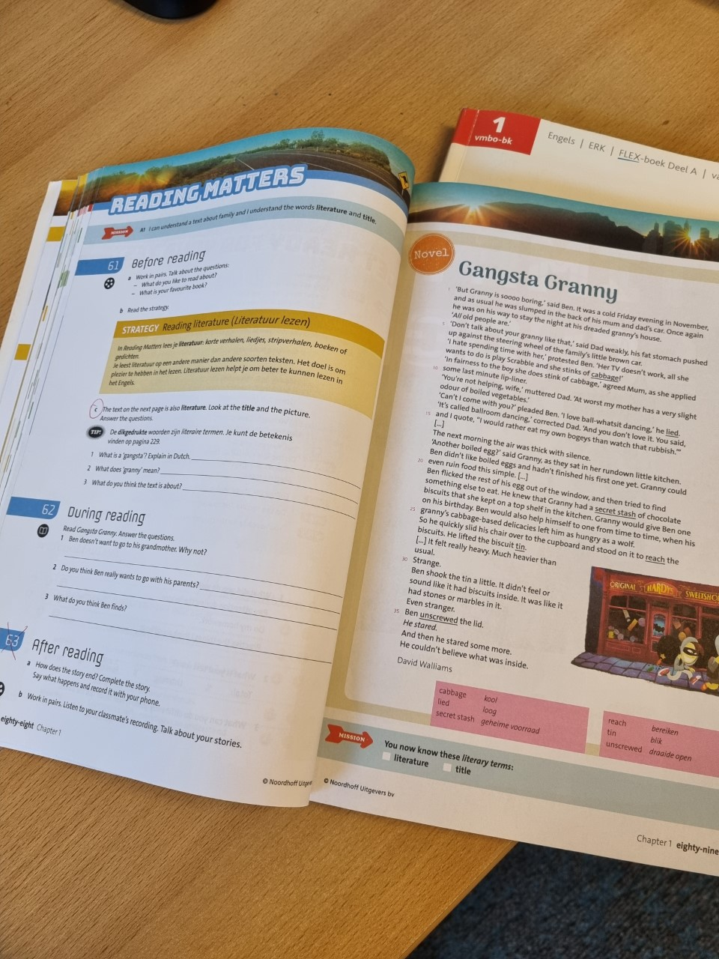
English lessons in secondary school

Slide 8
Mentimeter

Slide 9
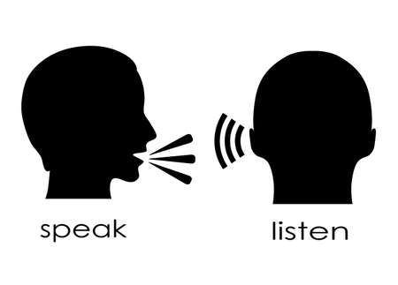
How do we bridge the gap?
iBuild it Erasmus project
CLPG
PLG
Tips and tricks
- Vocabulary
- Focus on speaking
- Make English fun again by using games
- Special workbook
- TOEFL learning groups

Slide 10
Any questions?

